Slide 1
Task one
Summary of reviews

Slide 2
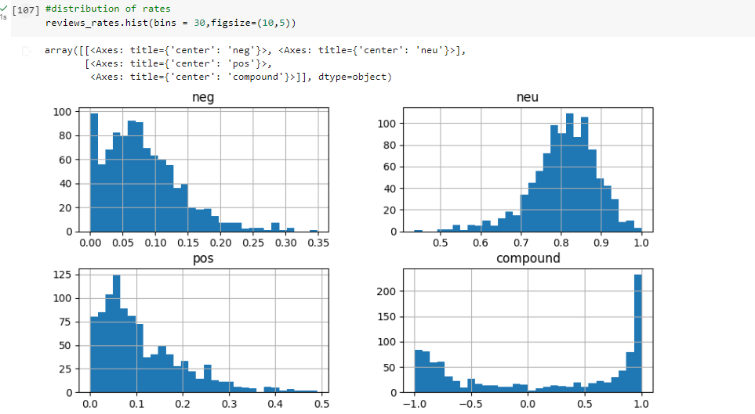
Distribution of the review rates

